Slide 1
Almond et al.
Babies born w/ low birth weight(< 2500 grams) are more prone to
Die early in life
Have health problems later in life
Educational difficulties
generated from cross-sectional regressions
6% of babies in US are low weight
Highest rate in the developed world

Slide 2
Let Y_{it} be outcome for baby t from mother I
e.g., mortality
Y_{it} = α + bw_{it} β + X_{i} γ + α_{i} + ε_{it}
bw is birth weight (grams)
X_{i} observed characteristics of moms
α_{i} unobserved characteristics of moms

Slide 3
Terms
Neonatal mortality, dies in first 28 days
Infant mortality, died in first year

Slide 4
Many observed factors that might explain health (Y) of an infant
Prenatal care, substance abuse, smoking, weight gain (of lack of it)
Some unobserved as well
Quality of diet, exercise, generic predisposition
α_{i} not included in model

Slide 5
Cross sectional model is of the form
Y_{it} = α + bw_{it} β + X_{i} γ + u_{it}
where u_{it} =α_{i} + ε_{it}
Cov(bw_{it},u_{it}) < 0
Same factors that lead to poor health lead to a marker of poor health (birth weight)

Slide 6
Solution: Twins
Possess same mother, same environmental characteristics, same pregnancy
Y_{i1} = α + bw_{i1} β + X_{i} γ + α_{i} + ε_{i1}
Y_{i2} = α + bw_{i2} β + X_{i} γ + α_{i} + ε_{i2}
ΔY = Y_{i2}-Y_{i1} = (bw_{i2}-bw_{i1}) β + (ε_{i2}- ε_{i1})

Slide 7
Questions to consider?
What are the conditions under which this will generate unbiased estimate of β?
What impact (treatment effect) does the model identify?

Slide 8
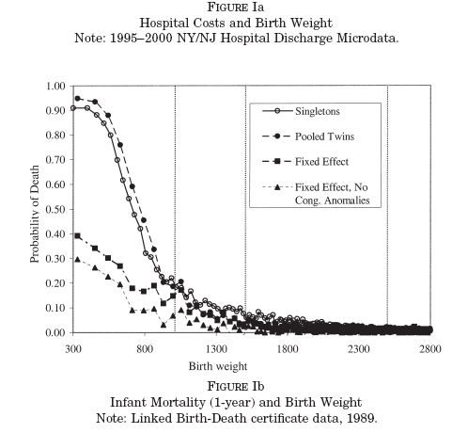

Slide 9
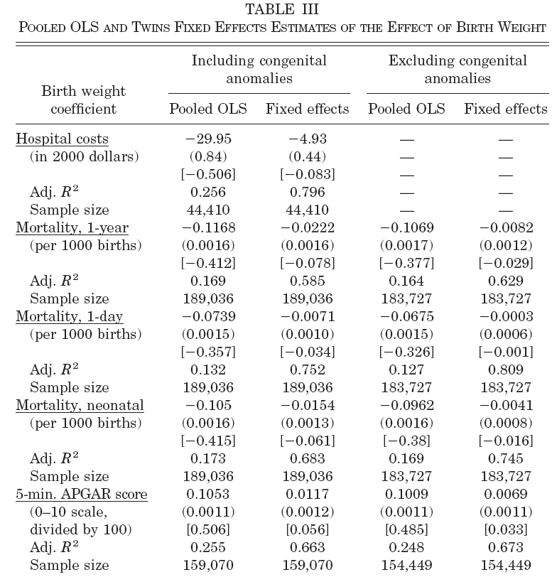

Slide 10
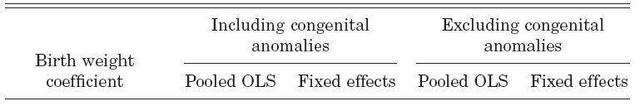
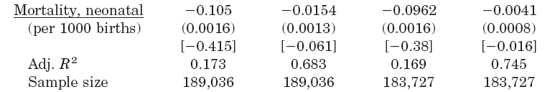
Big Drop in
Coefficient on
Birth weight
Large change
In R2

Slide 11
Teenage pregnancy
40% of teen women become pregnant before the age of 20
25% will be a mother by age 20
Most of these pregnancies end in a live birth
About 4 million children born each year, 1/8 are to teen mothers
8% of teen women, aged 15-19 give birth n a given year

Slide 12
Teen birth rates have changed considerably over time
Most of these births are out of wedlock
Rates differ considerably across race

Slide 13
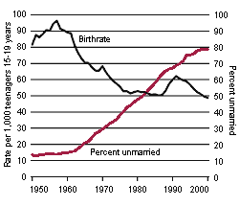

Slide 15
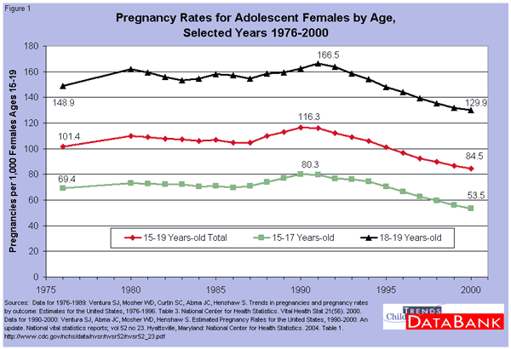

Slide 16
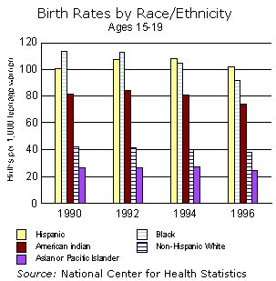

Slide 17
Outcomes of teen mothers
Teen mothers are
Twice as likely to not complete high school
90% less likely to attend college
At age 28 – teen mothers
50% more likely to be on poverty in their 20s
Have lower wages
Have more children
Have lower labor supply
Less likely to be married

Slide 18
Bill Clinton’s State of the Union Address, 1995
“We've got to ask our community leaders and all kinds of organizations to help us stop our most serious social problem: the epidemic of teen pregnancies and births where there is no marriage. “

Slide 19
Are poor economic outcomes ‘caused’ by early childbearing?
Teen mothers are not a random sample of the population
Teen mothers are more likely to come from situations that would predict poorer economic outcomes anyway

Slide 20
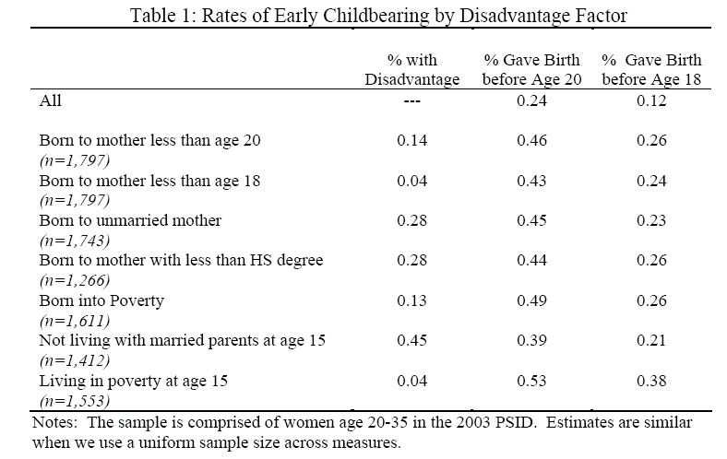

Slide 21
On average, teen mothers are more likely to come from:
families with lower income and education
poorer neighborhoods and lower quality schools
Families with a teen mother
Have Lower test scores
Racial and ethnic minorities

Slide 22
Consider an alternative explanation of results
Women with lowest opportunity cost of having children have more children
Women from poorer backgrounds lower opportunity cost of having children because they have lower economic prospects
In this example, teen motherhood does not ‘cause’ poor outcomes, but instead, is a signal of the same problem – poor future prospects

Slide 23
Cross sectional model is of the form
Y_{it} = α + TEENMOM_{it} β + X_{i} γ + u_{it}
Y is some economic outcome
u_{it} =α_{i} + ε_{it}
Cov(TEENMOM_{it},u_{it}) < 0

Slide 24
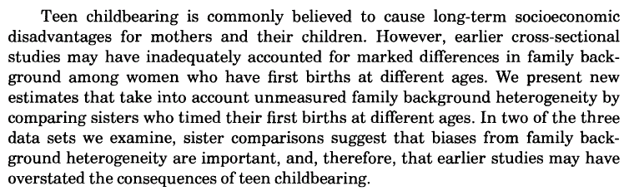

Slide 25
